Slide 1
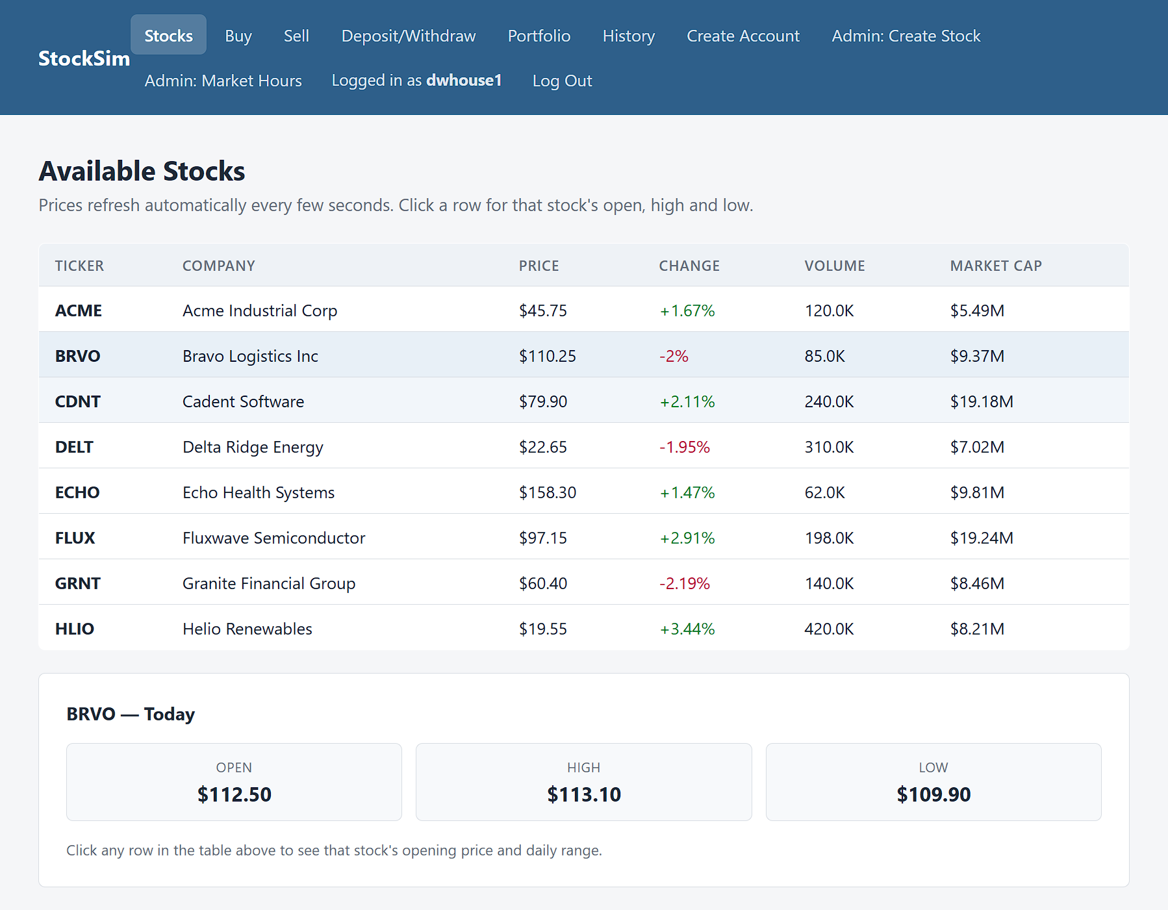
Function 1: View available stocks
What it does
Lists every active stock with its price, change, volume and market cap. Click a row to see its open and day high and low.
How it works
The page calls GET /stocks and refreshes every 5 seconds. The API reads PostgreSQL and computes market cap as volume x price.
Why it matters
It is the starting point for every trade, with real database values.
Notes:
This is the stock listing page. It shows every active stock with its ticker, company, current price, percent change, volume, and market cap. When I click a row, the panel underneath shows that stock's opening price and the day's high and low. The page calls GET /stocks and asks again every 5 seconds, the API reads the stocks table in PostgreSQL, and market cap is calculated as volume times price. This is real database data, not mock data.

Slide 2
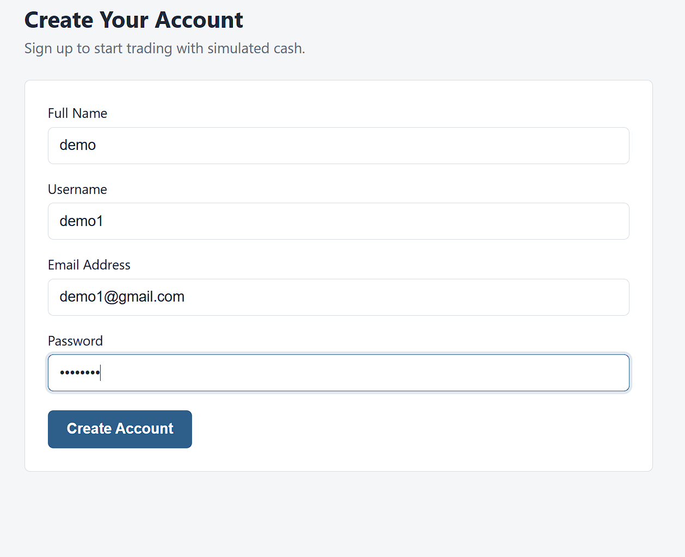
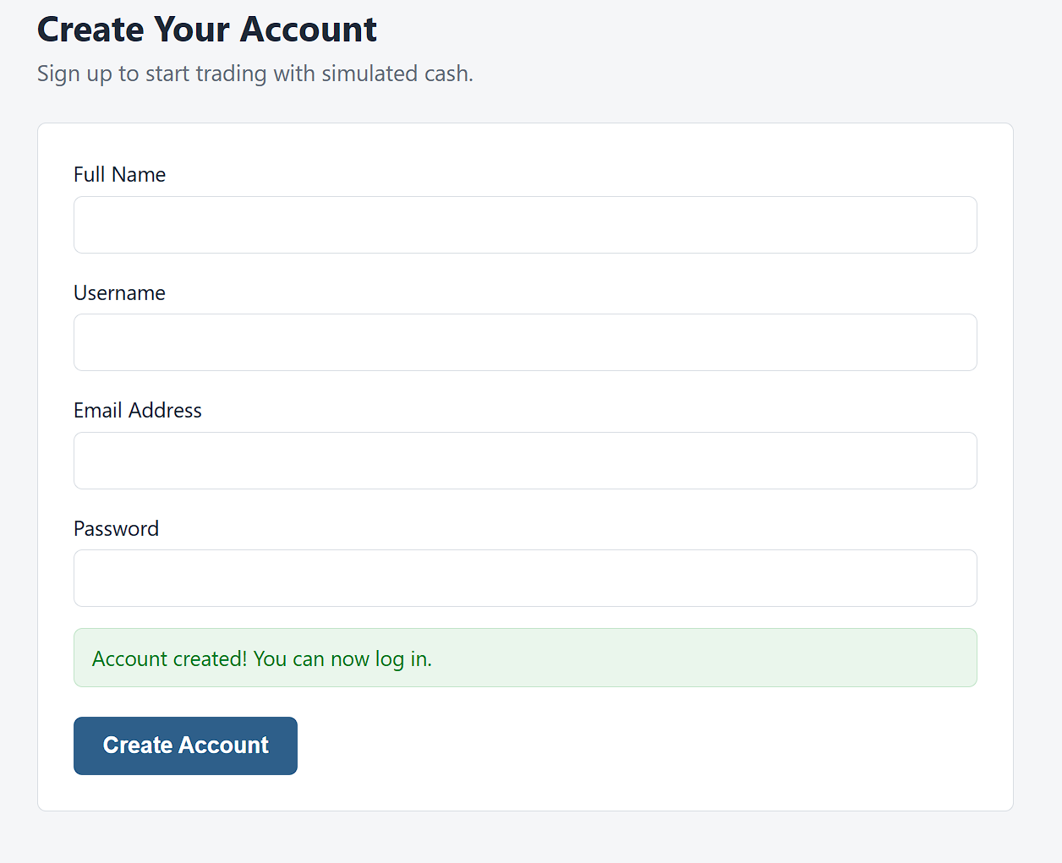
Function 2: Create a user account
What it does
A new customer enters a full name, username, email and password to create an account.
How it works
The page calls POST /users. The API hashes the password with bcrypt and saves a customer with $0.00 cash.
Checks
A duplicate username or email returns 409. Missing fields return 400. The duplicate case is shown on the next slide.
1. Form filled in
2. Account created
Notes:
The second function is creating an account. A new customer enters a full name, username, email, and password. The page calls the real POST /users endpoint. The password is hashed with bcrypt, and new accounts start as customers with zero cash. After a successful sign-up the page shows a green confirmation. A duplicate username or email gets a 409 and missing fields get a 400. I show the duplicate case on the next slide.

Slide 3
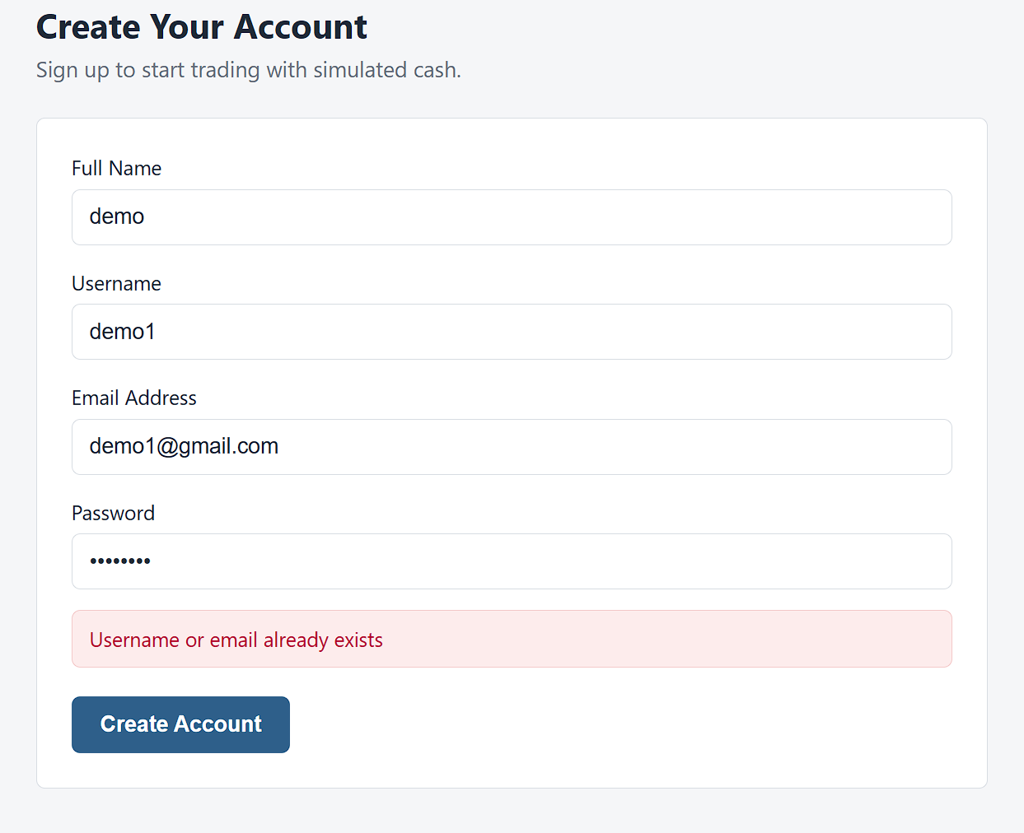
Function 2: Validation checks
What it does
The server rejects a sign-up that reuses a username or email, and the page shows the server's message in red.
How it works
POST /users returns 409 for a duplicate and 400 for missing fields. The form also requires every field and a password of at least 8 characters.
Why it matters
Each username and email belongs to exactly one account, so every login points to one customer.
Notes:
Here I submit the same username again. The API answers 409 and the page shows its message, Username or email already exists, so no two customers can share a username or email. The form itself also requires every field and a password of at least 8 characters.

